Slide 1
Online Table Reservation System “TableFleet”
Aman Awana
Aishwarya Pathak
Darshan Nayak
Ishan Parekh
Sihan Yang
Ushma Desai

Slide 2
Agenda:
Need of the online system
Business Idea
Scope of the idea
Technology stack we use
Cost Analysis
Revenue Model
Future goals and expectations
Demo

Slide 3




Why we need the online system?
Apart from good food, offering your clients a good overall experience is a master key to getting repeat clients
A long queue outside, with no predictability of the wait-time will increase the chances of customers going to competitors thus, affecting your business
Online table reservations will make your businesses available or visible to the customers, thereby making it convenient for them to make quick reservations
Ease of doing business increases by leveraging cutting edge technologies
This is where the need for an Online Table Reservation System comes up!!

Slide 4

Business idea and relevance
Hosting a website on cloud for restaurant table booking
Customers will fill up a registration form on our newly created website by choosing the restaurant from the list of available ones.
The information would include- name, contact number, number of people visiting and preferred time range prior to visiting the restaurant

Slide 5
Relevance
Effective restaurant service to customers
Flexibility to make reservations at any time and any place with 24/7 available service
Reducing waiting time for customers and improving upon customer service and restaurant ratings

Slide 6
Stakeholders
Customers
Investors
Restaurants
Project team (Development and Marketing Team)

Slide 7

Scope of the idea
Assumptions:
Considering the current pandemic scenario, the restaurants will not allow more than 10 persons per booking
Online Reservation of a table at the restaurant through a website
Website hosted on EC2
Registration form to be filed by the customer through phone or computer
Customer data is backed up using Amazon RDS
Functionalities:

Slide 8
Technology Stack Used:
Amazon EC2: Provides secure compute capacity in the cloud and it is used to deploy application
Amazon RDS: Provides cost-efficient and resizable capacity tasks such as database setup, patching and backups. Amazon RDS can be integrated with MySQL
GitHub: It is a code hosting platform for version control and the repository therein is used to collaborate with team
MySQL database: Used to provide database support for the applications/websites such as ours

Slide 9
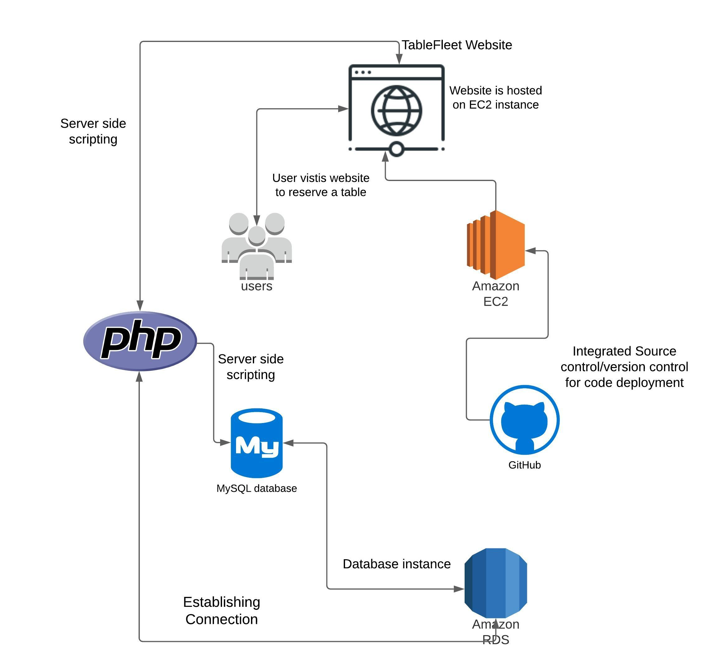
Product Architecture

Slide 10
Cost analysis:
The following cost analysis indicates cost that our team will incur while serving 1 restaurant’s needs. Here we have assumed a traffic of 100 customer reservations on average on daily basis:
NicePage
Amazon EC2
RDS
MySQL
database
GitHub,
php
3$/year per website - design tools, custom CSS, and Google Analytics support)
On demand service cost-
$ 176/restaurant per month @$0.704/hour
Free Tier-for 1st year - Thereafter we will incur “pay as you use” charges - 10$/month
Free
Free
Thus per restaurant cost per month: $190

Slide 11

Revenue Model:
Monthly/yearly subscription plans for small restaurants/café. We will have a fixed one-time cost of $50 for listing the restaurant on our website and a monthly service cost of $215 (includes 15% margin over the cost price)
Group subscription plans for chain of restaurants/cafe - 5% discounts will be given for the one-time cost, but the operational cost will remain the same
We plan to serve 5 restaurants in the 1st month and add 10 each to our list every subsequent month. Thus by the end of 1st year, we will have around 115 restaurants and we will be generating around $ 154,800(variable) in revenue and the net profit would be $23,220(variable)
We plan on charging additional amount to restaurants in future who would want to enroll for our future plans of including a full-fledged menu and pre-ordering facility on our website
Future Developments could include Room reservations and Payments as well. So that will bring small hotels and big companies having a chain of hotels under our business revenue umbrella

Slide 12

Future Goals and Expectations
Enable mobile notification/email service using AWS SES
Pre-ordering food and implementing payment gateway
Improve the online reservation system, expand the scope of application, through the user demand for timely adjustment
Deepen cooperation with restaurants, such as adding an advance order system, so that customers can enjoy more convenient and comprehensive services
Integrate our online system with the restaurant website to provide them with additional functionalities
Enabling tracking and analytical functions for the restaurants
Benefits restaurants to control capacity, track cancellations, manage walk-ins and follow safety guidelines

Slide 13
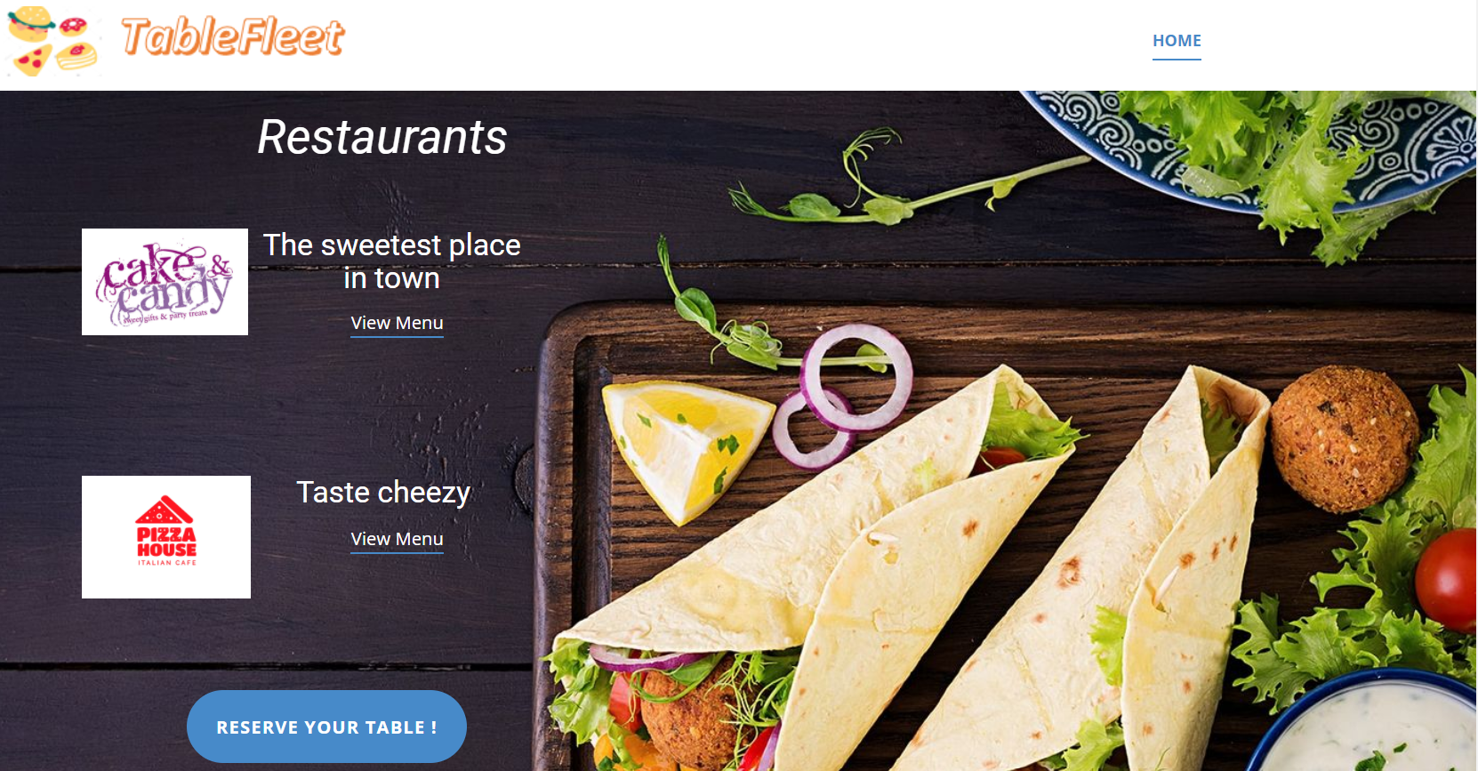
Demo:

Slide 14
THANK YOU!
Questions?
Any Feedback is most valuable to us!

